Slide 1

Online Fitness Training Platform
This online fitness training platform provides a comprehensive solution for individuals to achieve their fitness goals from the comfort of their own homes. The platform offers a wide range of interactive workout programs, personalized coaching, and a supportive community to help users stay motivated and engaged in their fitness journey.
Made by :
Yuvraj Tripathi (Team Leader ) , Bhavishya Kaushik , Pranjal Srivastava
, Shashank Kashyap
1

Slide 2
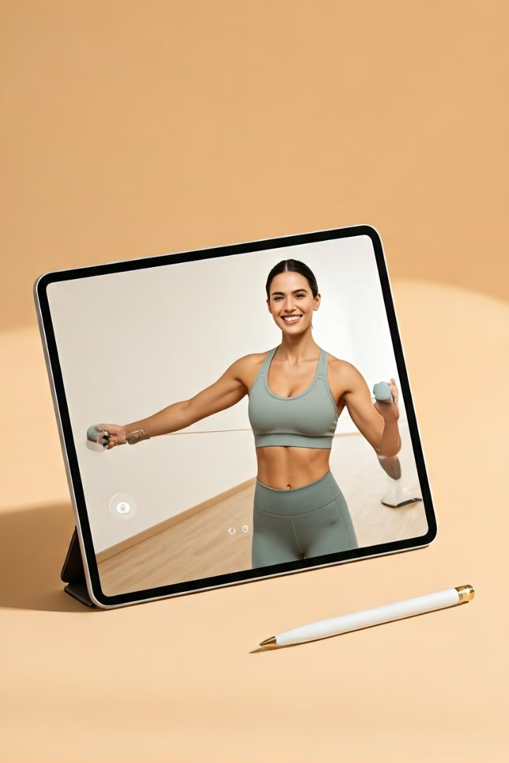
Introduction
1
Convenient and Accessible
2
Personalized Approach
The platform allows users to access fitness classes and training programs from anywhere, at any time, using their preferred device.
The platform offers customized workout plans and nutrition guidance based on each user's individual goals, preferences, and fitness level.
3
Interactive Community
Users can connect with a supportive community of fellow fitness enthusiasts, share their progress, and receive encouragement and advice.
2

Slide 3

Objective
Increase Access to Fitness
Foster a Supportive Community
Promote Healthy Lifestyles
The platform aims to empower individuals to take control of their health and fitness by providing a convenient and effective way to achieve their goals.
By offering virtual training sessions, the platform makes fitness accessible to those who may not have the time or resources to attend traditional in-person classes.
The platform creates a space where users can connect, motivate, and support one another in their fitness journeys.
3

Slide 4

Problem Statement
Sedentary Lifestyles
Lack of Personalization
Many individuals struggle to maintain a consistent exercise routine due to busy schedules, lack of motivation, or limited access to fitness facilities.
One-size-fits-all fitness programs may not effectively address the unique needs and goals of each individual, leading to frustration and lack of progress.
Isolation and Demotivation
Accessibility Barriers
Individuals with limited mobility, transportation, or financial resources may face barriers to accessing traditional fitness facilities and services.
Working out alone can be challenging, and the absence of a supportive community can make it difficult to stay motivated and accountable.
4

Slide 5
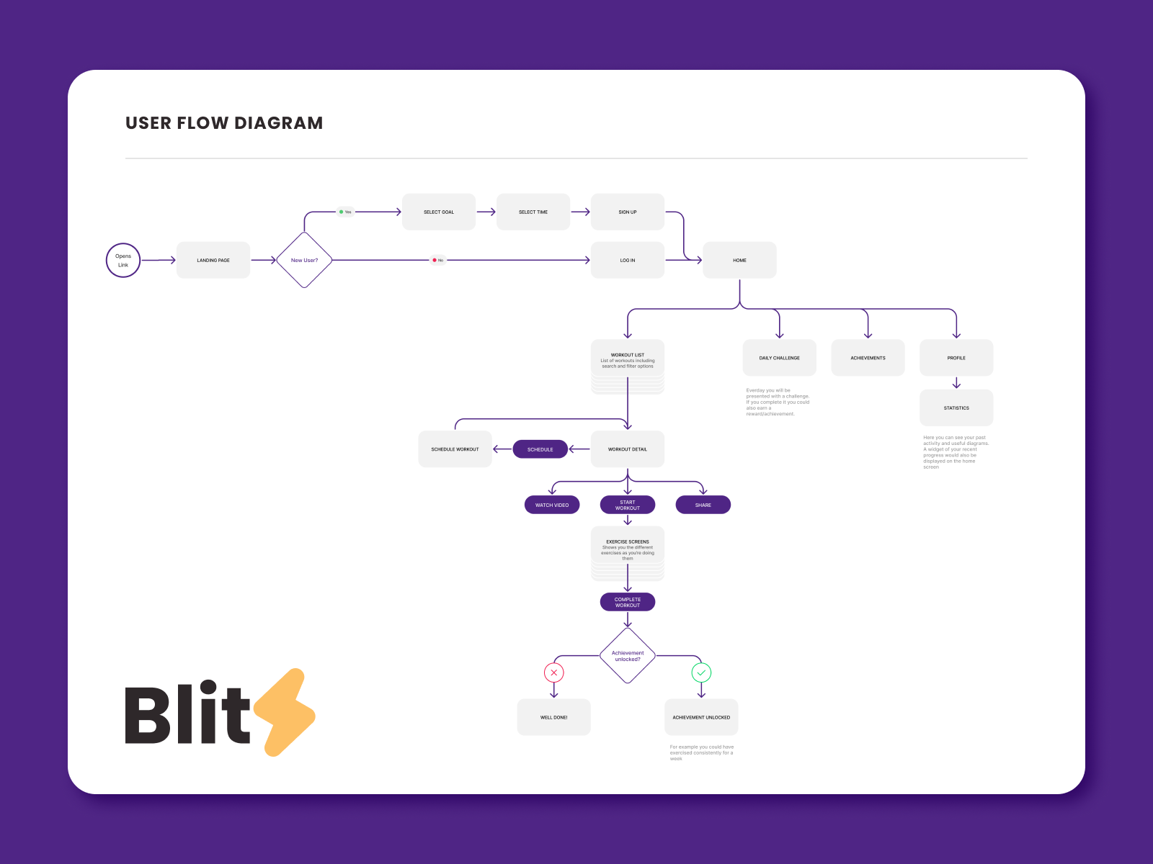
Flowchart
5

Slide 6





Technical Stacks
Mobile App
Web-based Platform
Responsive and user-friendly mobile application for seamless access to fitness content and tracking.
Intuitive web interface for desktop users to explore the platform's features and resources.
Video Streaming
Data Analytics
Robust video streaming capabilities to deliver high-quality, interactive workout sessions.
Advanced data analytics to provide personalized insights and track user progress.
6

Slide 7
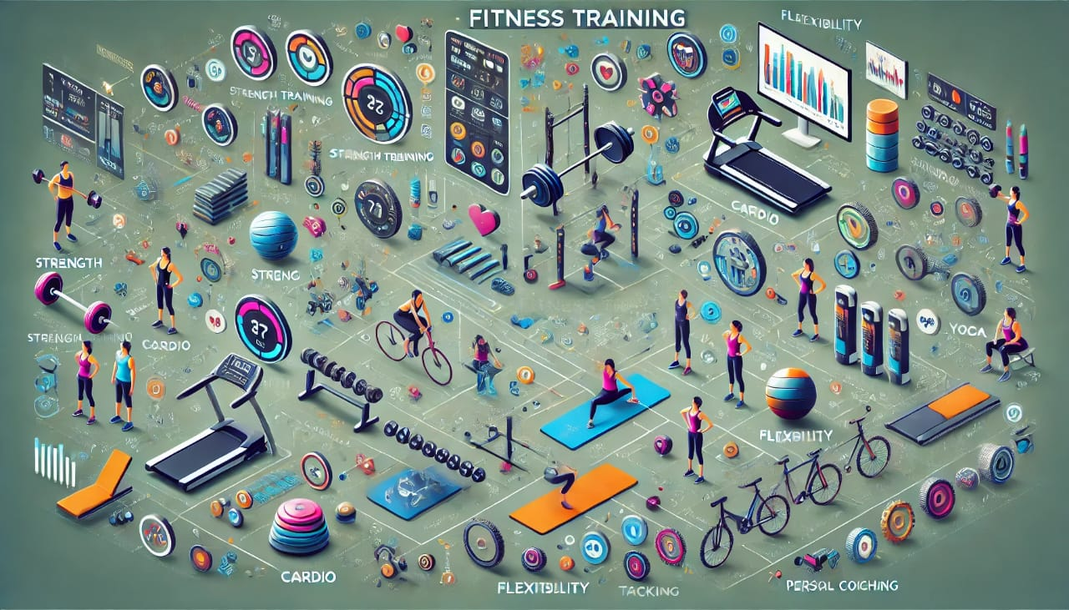
Features and Functionalities
Interactive Workout Programs
Personalized Coaching
Community Engagement
Users can access a wide range of pre-recorded and live-streamed workout classes, including strength training, cardio, yoga, and more.
Users can receive real-time feedback and guidance from certified fitness trainers during their workouts to ensure proper form and maximize results.
Users can connect with like-minded individuals, participate in group challenges, and share their progress and experiences in the platform's forums and social features.
7

Slide 8




User Experience
Intuitive Interface
The platform offers a clean and intuitive user interface, making it easy for users to navigate and access the desired features and content.
Engaging Visuals
High-quality visuals, including well-produced workout videos and motivational graphics, create an immersive and enjoyable user experience.
Seamless Integration
The platform seamlessly integrates with various devices and wearables, allowing users to track their progress and sync their fitness data.
8

Slide 9

Conclusion
1
Empowering Transformation
2
Accessible Fitness
By offering convenient and inclusive virtual fitness solutions, the platform breaks down barriers and makes fitness accessible to a wider audience.
The online fitness training platform empowers users to take control of their health and fitness, transforming their lives through personalized programs and a supportive community.
3
Sustainable Lifestyle
The platform's holistic approach, combining interactive workouts, personalized guidance, and community support, helps users develop sustainable healthy habits for long-term success.
9

